Slide 1
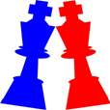
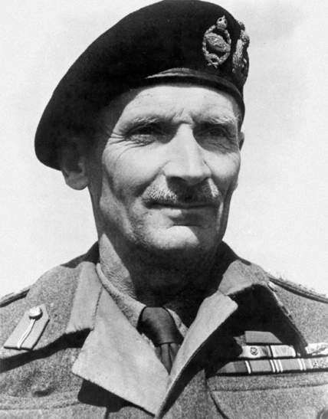
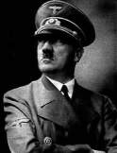
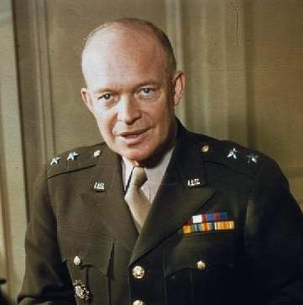
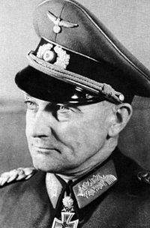
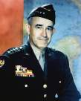
The Bulge
Dec 16, 1944-Jan 28, 1945
Strategic Context
After five years of war, the Allies gain a decisive advantage in June 1944 over Nazi Germany in World War II. Anglo-American forces land in northwestern France to open the Western Front, liberating Paris in August and capturing the first German city (Aachen) in November. On the Eastern Front, Soviet forces invade Belorussia, virtually destroying a German army group by August, and invade the Baltics and Balkans soon after. By August 1944, even Adolf Hitler recognizes that Germany cannot win a military victory. Instead, he seeks to win a decisive battlefield victory only to win a political victory by forcing one of his Allied enemies to make a separate peace with Germany. Hitler resolves to use his last mobile reserve in the West to break through the thinly-held American line in the Ardennes and capture Antwerp, splitting British-Canadian Army Group 21 in the north from American Army Group 12 in the south. This seemingly impossible feat is to be accomplished largely by his elite, fanatical Schutzstaffel (SS) divisions of 6. Panzer Army, assembled in great secrecy behind the line. Just as Dwight Eisenhower, commander of all Allied forces in the West, plans the final push into Germany, Hitler strikes.
Stakes
+ A German victory would halt any Allied attack into Germany as they expend all resources saving Army Group 21 from potential destruction.
+ An American victory would ruin Germany’s last reserve, leaving its borders weakened against future Anglo-American and Soviet attacks.
By Jonathan Webb, 2015

Slide 2
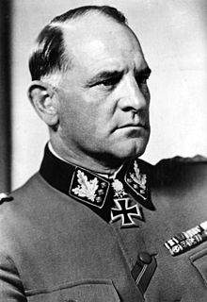
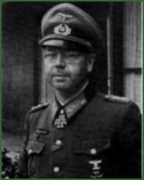
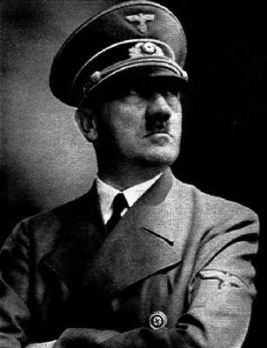
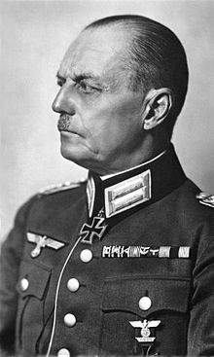
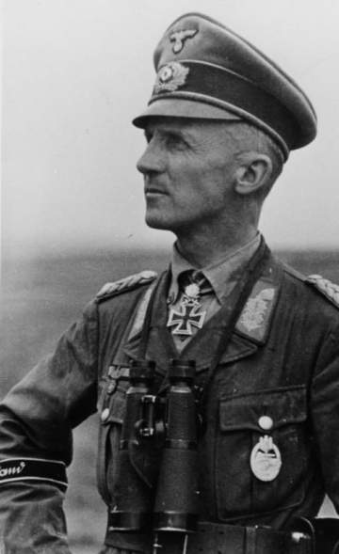
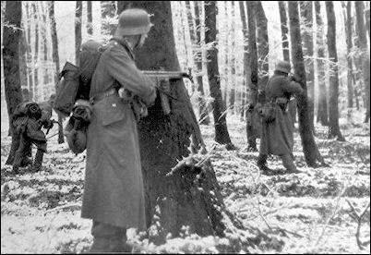
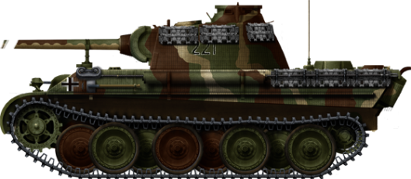
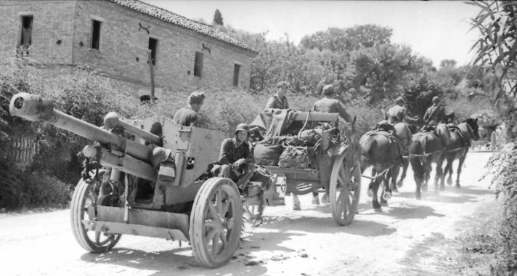
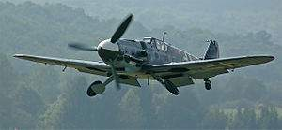
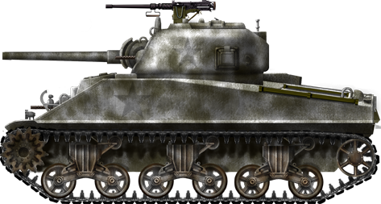
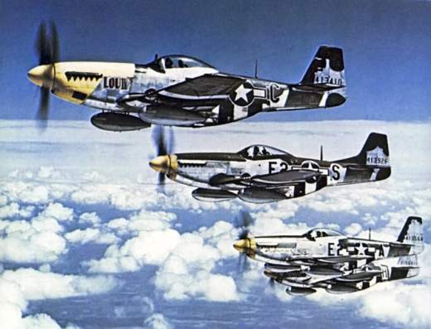
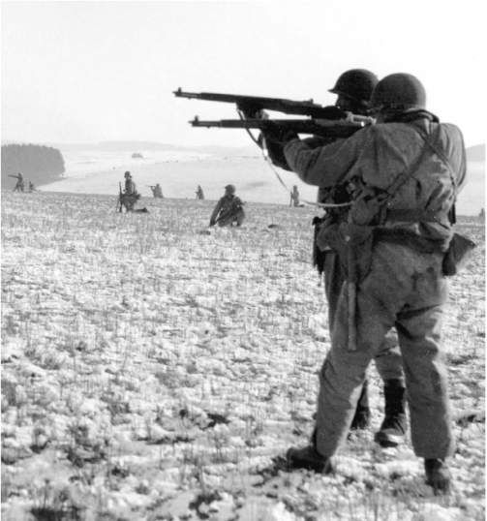
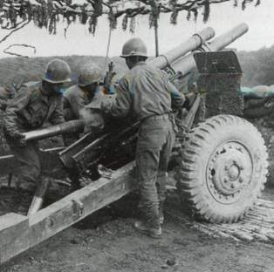
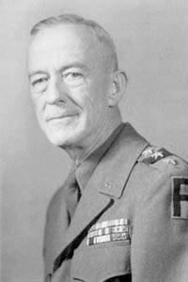
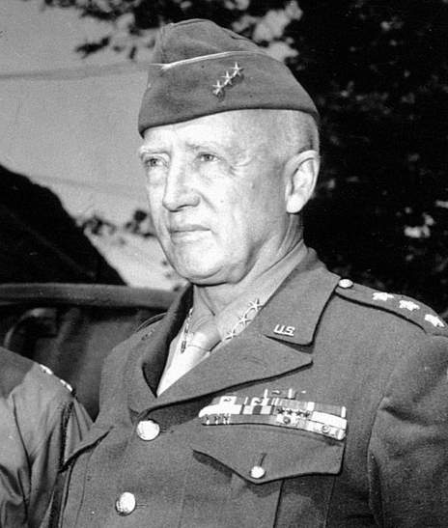
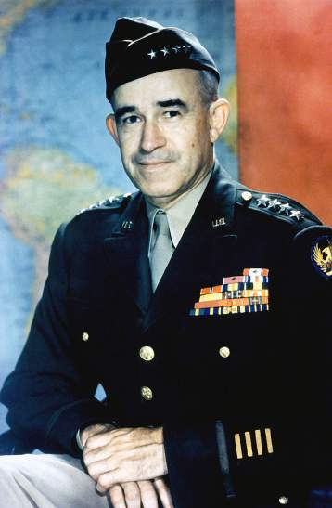
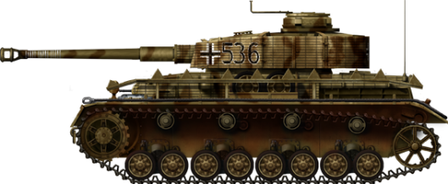
The Bulge, 1944-1945
Strength
American Army & allies
Initial Eventual
6 divisions 37 divisions
Well
German Army
Initial Eventual
18 divisions 28 divisions
Well
Dwight Eisenhower (SHAEF)
Adolf Hitler (C-in-C)
Omar Bradley (12. Army Group)
Gerd von Rundtsedt (OKW)
Bernard Montgomery (21. Army Group)
Walter Model (Army Group B)
Courtney Hodges (1. Army)
Josef Dietrich (6. Panzer Army)
George Patton (3. Army)
Hasso von Manteuffel (5. Panzer Army)
Erich Brandenburger (7. Army)
140,000 men 546,000 men
297,000 men 468,000 men
300 tanks 3,030 tanks
340 tanks 650 tanks
680 guns 3,520 guns
2,980 guns 4,110 guns
6,000 aircraft
2,400 aircraft
By Jonathan Webb, 2015

Slide 3
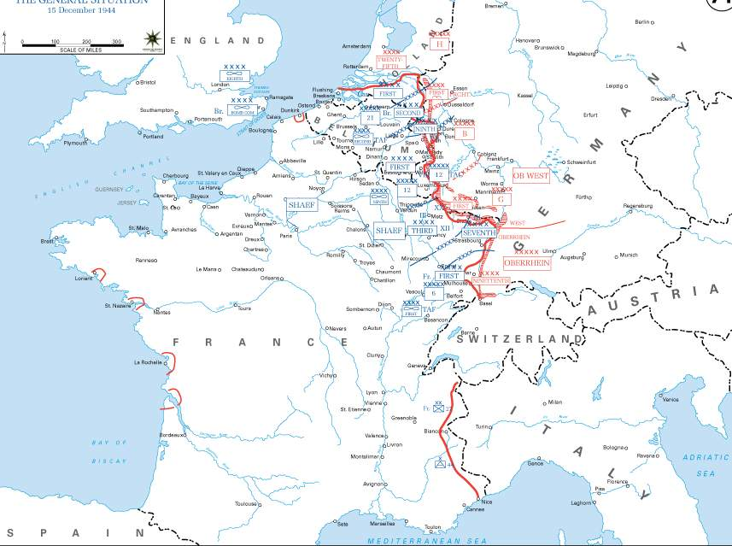
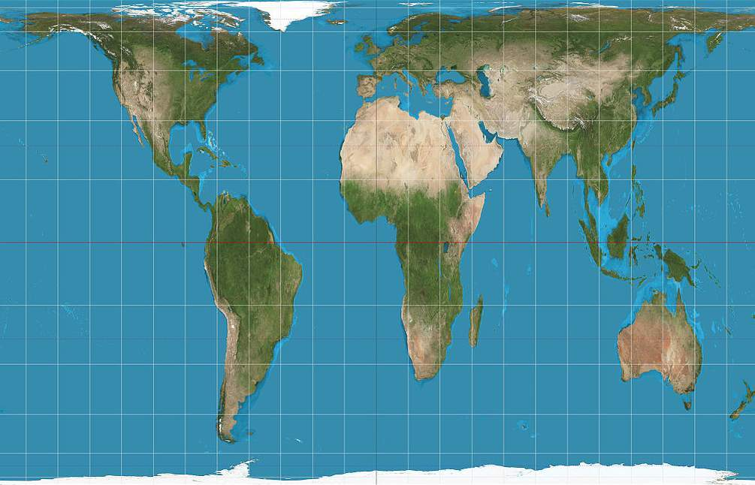
Western Europe c. Dec 15, 1944

Slide 4
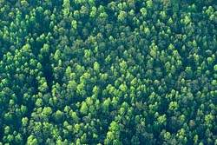




While the Ardennes battlefield is known for its dense forest, the terrain is extremely varied, and features a patchwork of forest, open area, ridges, plateaus, valleys, even bogs. The battlefield comprises three recognizable regions. In the north, the Low Ardennes is characterized by low, rolling hills. Relatively speaking, it contains the most open terrain although most of it is in the northwest corner of the battlefield such as the Herve and Condorz Plateaus, and the flat, open fields west of the Meuse River. In the east, Elsenborn Ridge features clear, rolling hills and dominates the area. The rest of the Low Ardennes features dense forest, especially in the Hohes Venn marshy plateau near Elsenborn Ridge and the Schnee Eiffel (Snow Mountains) between the Our and Prum Rivers. The valley of the Ambleve River and the Losheim Gap provide the only major lanes through
Herve Plateau
Vesdre River
Erft River
these features. South of the Low Ardennes, extending from the Ourthe River, southwest along the Lesse River is the Famenne Depression. This small region is a largely treeless low-lying plateau, and opens up to a wide crossing site across the Meuse River. In the south, the High Ardennes is characterized by dense forest and other difficult terrain, especially in the Foret d’Ardennes. The most significant lane through the High Ardennes is through the marshy Hautes Fagnes. The battlefield also contains a number of major rivers, many of which feature difficult approaches. Overall, the battlefield is characterized by difficult natural terrain with any advance relegated to using the few major lanes.
German Army
(Hitler/Model)
Meuse River
Hohes Venn
Low Ardennes
Roer River
Elsenborn Ridge
Condroz Plateau
Ambleve River
0
10 miles
Salm River
Losheim Gap
0
20 km
Ourthe River
Schnee Eifel
Meuse River
Famenne Depression
Our River
Lesse River
Prum River
Clerf River
Hautes Fagnes
Foret d’Ardennes
High Ardennes
Sure River
American Army & allies
(Eisenhower/Bradley/Montgomery)
Alzette River
Sauer River

Slide 5
In addition to the natural difficult terrain, the Ardennes battlefield features few major roads or population centers. With the exception of Liege, towns’ populations max out at between 2-4,000 and are mostly found along the few major roads. Control of the towns is vital to accessing the sparse road network, the most significant bottlenecks being St Vith and Werbemont in the north, and Bastogne in the south. Roads typically run north-south, meaning any westerly advance runs against the grain of the network. Aside from the major hard-surfaced roads, the battlefield also features winding, soft-packed trails through which only a
Herve Plateau
Vesdre River
Erft River
Liege
single vehicle can pass at one time, and which erode quickly. With the difficult natural terrain and mechanized advances confined to the few major lanes and roads, the terrain heavily favours the defender, and infantry generally. The German immediate objective is to seize the Meuse River crossing sites, crossing roughly between Liege and Huy in the north, and between Namur and Givet in the south. The German final objective is the capture of Antwerp (off map), just over 100km (65 miles) northwest of Liege. In the context of such a German offensive west, the key terrain includes Elsenborn Ridge, St Vith, and Bastogne, all of which dominate the road network and major lanes.
Verviers
Monschau
Meuse River
German Army
(Hitler/Model)
Hohes Venn
Roer River
Huy
Spa
Elsenborn Ridge
Condroz Plateau
Ambleve River
Namur
Malmedy
Werbemont
Stavelot
0
10 miles
Salm River
Losheim Gap
0
20 km
Ourthe River
Vielsalm
St Vith
Schnee Eifel
Dinant
Prum
Meuse River
Marche
La Roche
Our River
Rochefort
Houffalize
Lesse River
Prum River
Givet
Clervaux
Bitburg
Clerf River
St Hubert
Hautes Fagnes
Bastogne
Foret d’Ardennes
Vianden
Sure River
Diekirch
Echternach
American Army & allies
(Eisenhower/Bradley/Montgomery)
Neufchateau
Alzette River
Sauer River

Slide 6
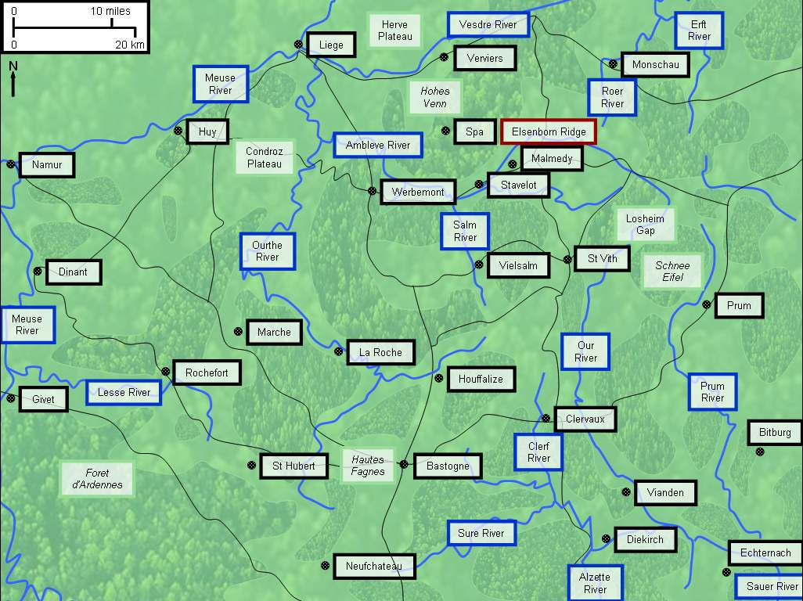
UK 29th Armoured Brigade
(Harvey)
5,700 men
145 tanks
52 guns
UK 53rd Infantry Division
(Ross)
18,000 men
0 tanks
72 guns
UK 43rd Infantry Division
(Thomas)
17,900 men
0 tanks
72 guns
101st Airborne Division
(McCauliffe)
16,300 men
0 tanks
91 guns
82nd Airborne Division
(Gavin)
11,600 men
0 tanks
68 guns
80th Infantry Division
(McBride)
16,600 men
27 tanks
66 guns
26th Infantry Division
(Paul)
16,700 men
56 tanks
96 guns
5th Infantry Division
(Irwin)
16,300 men
38 tanks
78 guns
4th Infantry Division
(Barton)
16,800 men
17 tanks
80 guns
106th Infantry Division
(Jones)
17,000 men
0 tanks
73 guns
99th Infantry Division
(Lauer)
16,500 men
15 tanks
85 guns
26th Volksgrenadier Division
(Kokott)
10,600 men
0 tanks
120 guns
560th Volksgrenadier Division
(Langhauser)
11,200 men
0 tanks
97 guns
UK 34th Armoured Brigade
(Clarke)
3,100 men
168 tanks
0 guns
1st Infantry Division
(Andrus)
15,800 men
50 tanks
82 guns
30th Infantry Division
(Hobbs)
17,200 men
77 tanks
114 guns
28th Infantry Division
(Cota)
17,000 men
53 tanks
78 guns
9th Infantry Division
(Craig)
15,500 men
47 tanks
90 guns
78th Infantry Division
(Parker)
16,000 men
33 tanks
88 guns
2nd Infantry Division
(Robertson)
17,200 men
38 tanks
98 guns
79th Volksgrenadier Division
(Weber)
10,100 men
0 tanks
92 guns
1. Army (as of Dec 16)
(Hodges)
7th Armoured Division – Hasbrouck
V Corps – Gerow
1st Infantry Division – Andrus
78th Infantry Division – Parker
99th Infantry Division – Lauer
2nd Infantry Division – Robertson
VIII Corps – Middleton
9th Armoured Division – Leonard
106th Infantry Division – Jones
28th Infantry Division – Cota
4th Infantry Division – Barton
1. Army (as of Dec 16)
(Hodges)
7th Armoured Division – Hasbrouck
V Corps – Gerow
1st Infantry Division – Andrus
78th Infantry Division – Parker
99th Infantry Division – Lauer
2nd Infantry Division – Robertson
VIII Corps – Middleton
9th Armoured Division – Leonard
106th Infantry Division – Jones
28th Infantry Division – Cota
4th Infantry Division – Barton
84th Infantry Division
(Boiling)
17,600 men
48 tanks
78 guns
75th Infantry Division
(Prickett)
16,000 men
57 tanks
64 guns
272nd Volksgrenadier Division
(Konig)
8,800 men
0 tanks
88 guns
12th Volksgrenadier Division
(Engel)
9,500 men
0 tanks
82 guns
6. Panzer Army (as of Dec 16)
(Dietrich)
I SS Panzer Corps – Priess II SS Panzer Corps – Bittrich
1st SS Panzer Division – Mohnke 2nd SS Panzer Division – Lammerding
12th SS Panzer Division – Kraas 9th SS Panzer Division – Stadler
3rd Fallschirmjager Division – Wadehn LXVII Corps - Hitzfeld
277th Volksgrenadier Division – Viebeg 272nd Volksgrenadier Division – Konig
12th Volksgrenadier Division – Engel 326th Volksgrenadier Division – Kaschner
150th Panzer Brigade – Skorzeny
Dec 15. Hitler deploys three armies, planning to attack west, crossing the Meuse River and capturing Antwerp. In the north, Dietrich’s 6. Panzer Army comprises 4 elite SS armoured or Panzer divisions (SS PzDs), 4 weaker infantry or Volksgrenadier divisions (VGDs), and 1 parachute or Fallschirmjager division (FJD). 6. Panzer Army is the strongest army deployed and represents the German main effort. Its immediate objective is to cross the Meuse between Liege and Huy within 24 hours; its final objective is the capture of Antwerp and to hold a line between it and the Meuse. In the center, Manteuffel’s 5. Panzer Army comprises 4 regular Panzer divisions (PzDs) and 5 VGDs. 5. Panzer Army represents the German secondary effort. Its immediate objective is to cross the Meuse near Namur within 24 hours; its final objective is to shield 6. Panzer Army’s southern
Dec 16. After a 30-minute artillery barrage, the Germans attack along the front at 0600. In the north, Dietrich leads with his infantry; the 277th and 12th VGDs rush forward but suffer heavy casualties against the US 2nd and 99th IDs, reporting slow progress and bitter forest fighting. The 3rd FJD also attacks but is frustrated by small US detachments blocking main roads. US troops occupy all advance routes by the end of the day, but also suffer many casualties and recognize they are outnumbered. Dietrich, frustrated with his infantry’s progress, orders his elite SS PzDs forward, but they are stuck in traffic behind the front. In the center, Manteuffel makes better progress. The US 106th ID offers stubborn resistance against the part of the 18th VGD, while the rest of the VGD circles around both flanks to surround it. The 26th VGD crosses the Our during the night to assist
Dec 17-18. As the German attack grows, Eisenhower orders his strategic reserve, 2 elite airborne divisions (AbnDs), to backstop the line and hold critical road junctions, Werbemont and Bastogne, while Hodges sends CCB/9th AD south to hold St. Vith. In the north, the 272nd and 326th VGDs attack the 78th ID at Monschau but are repelled by artillery; the threat ends when part of US 9th ID arrives. 1st ID, 30th ID and CCR/3rd AD also arrive from 9. and 1. Army reserves from the north. Dietrich commits 12th SS PzD to assist the stalled 277th and 12th VGDs, forcing Hodges’ corps commander, Gerow, to withdraw 2nd and 99th IDs towards Elsenborn Ridge. Dietrich makes the most progress along the Ambleve River where the 1st SS PzD unleashes Kampfgruppe (KG) Peiper, which pushes west relentlessly as far as Stavelot. In the center, Manteuffel achieves a
Dec 19-20. Eisenhower and his subordinates meet face to face, where they decide to hold strong shoulders on each side of the bulge, preventing the German breakthrough from widening. Montgomery will command all forces north of bulge, Bradley the south. Eisenhower orders Patton to turn his 3. Army 90 degrees and attack north within two days. In the north, 12th SS PzD sidesteps US forces on Elsenborn Ridge, and attacks north, supported by infantry, but is repelled twice. KG Peiper is meanwhile contained and then attacked by 30th ID, supported by CCB/3rd AD. 9th SS PzD, Fuhrer Begleit Brigade (FBB), and 150th Pz Brigade (PzB) finally arrive in the salient to force a breakthrough, after being stuck in traffic and then suffering fuel issues. Hitler transfers 6. Pz Army’s 2nd SS PzD south to support 5. Pz Army’s more promising attack however. In the center, 106th ID
Dec 23-24. The weather finally clears, allowing Allied aircraft to fill the sky, pummeling German units throughout the battlespace, from frontline units to rear supply columns. Recognizing 6. Pz Army is bogged down, Model shifts the German main effort to 5. Pz Army’s north wing, transferring 18th and 62nd VGDs to 6. Pz Army. US 30th ID and CCR/3rd AD continue to attack KG Peiper; the Luftwaffe attempts to resupply it by air but its supplies land in 30th ID positions. 9th SS PzD attacks 82nd AbnD, but its attack is smashed by an Allied air strike using napalm. In the center, Hodges allows the corps commander at St. Vith to decide to withdraw from the St. Vith fortified goose egg, complicated by FBB’s attack. In the center 2nd SS PzD attacks northwest, surprising 7th AD and threatening 82nd AbnD with encirclement. 560th VGD and 116th PzD also attack northwest but cannot
Dec 21-22. With Zangen’s 15. Army taking control of 272nd and 326th VGDs, Dietrich shifts his focus further south. German attacks fail to dislodge American defenders of Elsenborn Ridge, taking heavy casualties from effective artillery fire. KG Peiper repels attacks from all sides but becomes surrounded and is out of fuel. 1st SS PzD attacks west but is blocked by US 82nd AbnD; Hitler rejects pleas to allow Peiper to break out east, forcing relief forces to withdraw. North of St. Vith, 9th SS PzD struggles to move due to poor roads and lack of fuel, but bypasses 7th AD and moves west while FBB attacks. This attack assists Manteuffel’s 18th and 62nd VGDs, which finally wrestle St. Vith from the US 7th AD, CCB/9th AD, and remnants of other units. In the center, 116th PzD rapidly advances northwest but is blocked by CCR/3rd AD, and backtracks to bypass it while 560th VGD
flank by holding a line between Antwerp and Givet. In the south, Brandenburger’s ill-supported 7. Army comprises only 3 VGDs and 1 FJD. Its immediate objective is to shield 5. Panzer Army’s southern flank as it crosses the Meuse; its final objective is to protect the Panzer Armies’ southern flank as they race for Antwerp by holding a line between Givet and Echternach. For the US, Hodges deploys 1. Army’s 5 infantry divisions (IDs) in a thinly held line, with his sole armoured division (AD) split up into 3 combat commands (CCs) as sector reserves. Neither Hodges nor his superiors any German attack. Note: in text, German units appear in italics, Allied units in normal font. Click any army label or unit for more information.
560th VGD attacking US 28th ID, which frustrates their attacks; German engineers finally build a bridge across the Our later in the day, allowing 2nd PzD to push 28th ID back to Clerveaux. Most of Manteuffel’s PzDs remain stuck in traffic behind the front however. In the south, Brandenburger’s forces advance but achieve no breakthroughs, partly because his army still has not received its promised assault guns to assist his infantry. 5th FJD and 352nd VGD advance west against modest resistance; 276th VGD is violently checked by CCA/9th AD; 212th VGD achieves only minor penetrations against 4th ID. Eisenhower reacts to reports of German counterattacks in Ardennes by transferring the 7th and 9th ADs to 1. Army from adjacent 9. and 3. Armies.
wider breakthrough. 18th VGD surrounds most of 106th ID, which vainly tries to break out west, while 62nd VGD pushes west and faces newly arrived 7th AD at St. Vith. 28th ID offers stiff resistance against parts of five German divisions, but is forced back with heavy casualties. 2 CCs occupy Bastogne as Manteuffel’s 3 PzDs exploit the breakthrough. In the south, Brandenburger makes frustratingly slow progress. 5th FJD advances as 28th ID retreats. 352nd and 276th VGDs advance but face stiff counterattacks by US tanks in the form of 2 CCs. 4th ID halts 212th VGD’s penetration but has some units isolated in Echternach.
surrenders, allowing 18th and 62nd VGD to push on towards St. Vith. 116th PzD and 560th VGD capture Houffalize and push west until clashing with CCR/3rd AD while 2nd PzD skirts Bastogne and crosses the Ourthe, but runs out of fuel and must halt. US 101st AbnD reinforces Bastogne, deterring PzD Lehr and 26th VGD from a major assault for now. In the south, 5th FJD nearly captures the remnant headquarters of retreating 28th ID while 352nd VGD captures Diekrich. CCA/10th AD counterattacks 212th VGD until 276th VGD finally receives its promised assault guns and pushes both US CCs back. With the expected arrival of Patton’s 3. Army, Brandenburger prepares to go over to the defensive; 7. Army receives Fuhrer Grenadier Brigade (FGB) to assist in its task of stymieing the well-respected tank commander.
break through. 2nd PzD approaches the Meuse but runs low on fuel while PzD Lehr becomes engaged in Rochefort mopping up US forces; 9th PzD slowly advances west to assist these spearhead divisions. German forces massing around Bastogne meanwhile suffer heavily from Allied air attacks. In the south, Brandenburger is reinforced by 9th and 79th VGDs to hold out against Patton’s growing attacks. 5th FJD is pushed back by 4th AD but holds firm while 352nd VGD barely escapes encirclement by 80th ID; FGB and 79th VGD counterattack but produce only casualties. A build-up of 3. Army artillery helps 5th ID and part of 10th AD to push 212th VGD back towards the Sauer River.
takes its place. 2nd PzD sits idle awaiting fuel for a full day before advancing west, only to be blocked by newly arrived 84th ID, 1 of 3 US divisions to arrive in the center. Montgomery also begins deploying UK units along the Meuse to block the west in case of a German breakthrough. At Bastogne, 101st AbnD repulses an attack by PzD Lehr and a night attack by 26th VGD. PzD Lehr advances west, completely surrounding 2 CCs and 101st AbnD; when asked to surrender, its commander, McCaullife, simply replies, “Nuts!” In the south, Brandenburger’s divisions capture a few villages and terrain in bitter fighting before going over to the defensive. Patton attacks with 3 divisions but only gets within 8 km (5 miles) of Bastogne against tough resistance by 5th FJD and 352nd VGD.
German Army
(Hitler/Model)
1. Army (Hodges)
326th Volksgrenadier Division
(Kaschner)
9,100 men
0 tanks
97 guns
18th Volksgrenadier Division
(Hoffman-Schonborn)
12,100 men
0 tanks
100 guns
6. Panzer Army (Dietrich)
0
10 miles
0
20 km
Landmarks
246th Volksgrenadier Division
(Korte)
8,500 men
0 tanks
88 guns
62nd Volksgrenadier Division
(Kittel)
11,100 men
0 tanks
97 guns
9th Armoured Division
(Leonard)
12,000 men
176 tanks
54 guns
4th Armoured Division
(Gaffey)
11,300 men
111 tanks
111 guns
7th Armoured Division
(Hasbrouck)
12,000 men
149 tanks
54 guns
1. Army (Hodges)
5. Panzer Army (Manteuffel)
277th Volksgrenadier Division
(Viebeg)
7,300 men
0 tanks
88 guns
167th Volksgrenadier Division
(Hocker)
11,000 men
0 tanks
82 guns
5th Armoured Division
(Oliver)
12,600 men
137 tanks
54 guns
10th Armoured Division
(Morris)
12,000 men
153 tanks
54 guns
2nd Armoured Division
(Harmon)
18,400 men
239 tanks
84 guns
5. Panzer Army (as of Dec 16)
(Manteuffel)
LVIII Panzer Corps – Kruger
116th Panzer Division – Waldenburg
560th Volksgrenadier Division – Langhauser
XLVII Panzer Corps – Luttwitz
2nd Panzer Division – Lauchert
Panzer Lehr Division – Bayerlein
26th Volksgrenadier Division – Kokott
LXVI Corps – Lucht
18th Volksgrenadier Division – Hoffman-Schonborn
62nd Volksgrenadier Division – Kittel
7. Army (Brandenburger)
Symbol guide
American Army & allies
(Eisenhower/Bradley/Montgomery)
3. Army (Patton)
3. Army (Patton)
276th Volksgrenadier Division
(Mohring)
9,300 men
0 tanks
88 guns
212th Volksgrenadier Division
(Sensfuss)
11,200 men
0 tanks
97 guns
3rd Armoured Division
(Rose)
15,300 men
196 tanks
94 guns
116th Panzer Division
(Waldenburg)
15,500 men
49 tanks
40 guns
150th Panzer Brigade
(Skorzeny)
3,000 men
1 tank
0 guns
Led by famous German commando, Otto Skorzeny, 150th PzBde is intended for use as a special operations unit. By disguising itself as a US unit, its objective is to infiltrate US lines as 6. Pz Army breaks through, and seize at least two bridges across the Meuse. However, the unit becomes stuck in traffic behind the front, and 6. Pz Army does not completely break through US lines. On Dec 20, Skorzeny requests his unit be committed as a regular combat unit, which Dietrich agrees to.
15th Panzergrenadier Division
(Deckert)
11,200 men
11 tanks
55 guns
352nd Volksgrenadier Division
(Schmidt)
10,600 men
0 tanks
97 guns
5th Fallschirmjager Division
(Heilmann)
16,300 men
0 tanks
72 guns
2nd Panzer Division
(Lauchert)
14,600 men
72 tanks
86 guns
Panzer Lehr Division
(Bayerlein)
14,900 men
72 tanks
88 guns
11th Panzer Division
(Wietersheim)
14,500 men
52 tanks
48 guns
9th Panzer Division
(Elverfeldt)
13,900 men
38 tanks
49 guns
3rd Panzergrenadier Division
(Denkert)
11,400 men
0 tanks
44 guns
3rd Fallschirmjager Division
(Wadehn)
12,500 men
0 tanks
25 guns
12th SS Panzer Division
(Kraas)
20,700 men
70 tanks
172 guns
9th SS Panzer Division
(Stadler)
13,300 men
66 tanks
73 guns
2nd SS Panzer Division
(Lammerding)
17,000 men
76 tanks
80 guns
1st SS Panzer Division
(Mohnke)
21,300 men
97 tanks
142 guns
7. Army (as of Dec 16)
(Brandenburger)
LXXX Corps – Beyer
276th Volksgrenadier Division – Mohring
212th Volksgrenadier Division – Sensfuss
LXXXV Corps – Kneiss
5th Fallschirmjager Division – Heilmann
352nd Volksgrenadier Division – Schmidt
American Army & allies German Army
Infantry division Infantry division
Airborne division Airborne division
Armoured division Armoured division
Armoured brigade Mechanized division
UK infantry division SS armoured division
UK airborne division SS armoured brigade
UK armoured division SS kampfgruppe
UK armoured brigade SS mechanized brigade
Fuhrer Begleit Brigade
(Remer)
7,000 men
26 tanks
16 guns
Fuhrer Grenadier Brigade
(Kahler)
6,900 men
39 tanks
49 guns

Slide 7
UK 33rd Armoured Brigade
(Scott)
3,500 men
191 tanks
0 guns
UK 29th Armoured Brigade
(Harvey)
5,700 men
145 tanks
52 guns
UK 53rd Infantry Division
(Ross)
18,000 men
0 tanks
72 guns
UK 43rd Infantry Division
(Thomas)
17,900 men
0 tanks
72 guns
UK 51st Infantry Division
(Rennie)
17,800 men
0 tanks
72 guns
17th Airborne Division
(Miley)
14,100 men
0 tanks
70 guns
101st Airborne Division
(McCauliffe)
16,300 men
0 tanks
91 guns
82nd Airborne Division
(Gavin)
11,600 men
0 tanks
68 guns
80th Infantry Division
(McBride)
16,600 men
27 tanks
66 guns
26th Infantry Division
(Paul)
16,700 men
56 tanks
96 guns
5th Infantry Division
(Irwin)
16,300 men
38 tanks
78 guns
4th Infantry Division
(Barton)
16,800 men
17 tanks
80 guns
99th Infantry Division
(Lauer)
16,500 men
15 tanks
85 guns
26th Volksgrenadier Division
(Kokott)
10,600 men
0 tanks
120 guns
560th Volksgrenadier Division
(Langhauser)
11,200 men
0 tanks
97 guns
340th Volksgrenadier Division
(Tolsdorff)
7,100 men
0 tanks
78 guns
UK 34th Armoured Brigade
(Clarke)
3,100 men
168 tanks
0 guns
UK 6th Airborne Division
(Bols)
14,600 men
0 tanks
51 guns
1. Army (as of Dec 24)
(Hodges)
UK 29th Armoured Brigade – Harvey
V Corps – Gerow XVIII Airborne Corps – Ridgeway
1st Infantry Division – Andrus 7th Armoured Division – Hasbrouck
78th Infantry Division – Parker 3rd Armoured Division – Rose
99th Infantry Division – Lauer 9th Armoured Division – Leonard
2nd Infantry Division – Robertson 82nd Airborne Division – Gavin
VII Corps – Collins 30th Infantry Division – Hobbs
2nd Armoured Division – Harmon
84th Infantry Division – Boiling
75th Infantry Division – Prickett
UK Guards Armoured Division
(Adair)
14,300 men
237 tanks
48 guns
1st Infantry Division
(Andrus)
15,800 men
50 tanks
82 guns
30th Infantry Division
(Hobbs)
17,200 men
77 tanks
114 guns
28th Infantry Division
(Cota)
17,000 men
53 tanks
78 guns
9th Infantry Division
(Craig)
15,500 men
47 tanks
90 guns
78th Infantry Division
(Parker)
16,000 men
33 tanks
88 guns
2nd Infantry Division
(Robertson)
17,200 men
38 tanks
98 guns
79th Volksgrenadier Division
(Weber)
10,100 men
0 tanks
92 guns
9th Volksgrenadier Division
(Kolb)
8,700 men
0 tanks
87 guns
89th Infantry Division
(Bruns)
12,000 men
0 tanks
97 guns
6. Panzer Army (as of Dec 24)
(Dietrich)
I SS Panzer Corps – Priess LXVII Corps – Hitzfield
1st SS Panzer Division – Mohnke 3rd Panzergrenadier Division – Denkert
12th SS Panzer Division – Kraas 3rd Fallschirmjager Division – Wadehn
150th Panzer Brigade – Skorzeny 277th Volksgrenadier Division – Viebeg
II SS Panzer Corps – Bittrich 12th Volksgrenadier Division – Engel
9th SS Panzer Division – Stadler LXVI Corps – Lucht
Fuhrer Begleit Brigade – Remer 18th Volksgrenadier Division – Hoffman-Schonburn
62nd Volksgrenadier Division – Kittel
84th Infantry Division
(Boiling)
17,600 men
48 tanks
78 guns
75th Infantry Division
(Prickett)
16,000 men
57 tanks
64 guns
272nd Volksgrenadier Division
(Konig)
8,800 men
0 tanks
88 guns
12th Volksgrenadier Division
(Engel)
9,500 men
0 tanks
82 guns
Dec 25-26. Montgomery continues to backstop the American position in the Ardennes by deploying UK units all along the Meuse. In the north, fighting begins to quiet down as VGDs relieve 3rd Panzergrenadier Division (PzGD), 150th PzBde, and 1st SS PzD for combat elsewhere. Meanwhile, KG Peiper breaks out east, leaving most if its equipment behind. The only serious fighting occurs when 9th SS PzD attacks 82nd AbnD as Montgomery withdraws it to shorten the line and avoid encirclement. In the center, both sides attack unsuccessfully. 2nd SS PzD relentlessly tries to breakthrough the US line but is thrown back by US fire support, and then counterattacked by most of 3rd AD; 75th ID and CCA/3rd AD attack 560th VGD with heavy casualties; 84th ID repels an attack by 116th PzD and FBB. Montgomery unleashes 2nd AD, from “Lightning Joe” Collins’ corps,
Dec 27-28. Allied aircraft continue to rake the Germans across the battlefield until a snowstorm grounds them. The German main effort shifts to the center as Hitler orders Bastogne to be taken at all costs, sending 1st SS PzD, 15th PzGD, and newly arrived 167th VGD to accomplish this. By now, Hitler recognizes the offensive’s grand aims cannot be achieved. In the north, Dietrich’s 6. Pz Army tries again to break through US lines but fails; US artillery blows apart a final attack by 246th and 12th VGDs against Elsenborn Ridge. 9th SS PzD and 62nd VGD attack 82nd AbnD but are repelled and counterattacked in turn. In the center, 2nd and 12th SS PzDs make some progress against 3rd and 7th ADs before they counterattack, regaining some ground. 560th VGD tries to support this effort but its strength is clearly spent. At the tip of the German advance, 2nd PzD withdraws,
Dec 29-30. In the north, where Zangen’s 15. Army extends its command, the line is inactive except for raids by 99th ID. Dietrich’s 6. Pz Army tries one last time to break through US lines, attacking with 3 SS PzDs but the attack bogs down against US artillery and ADs; Hitler pulls 12th SS PzD out of the line to be sent to the Bastogne front. In the center, 83rd ID violently attacks Manteuffel’s spent PzDs at the tip of the bulge; the PzDs repel US attacks with difficulty before retreating from Rochefort altogether. Montgomery allows UK divisions to cross the Meuse to the front, pulling US 2nd and 3rd ADs back into reserve. At Bastogne, Manteuffel attempts to reseal the corridor into the town with two major pincer attacks: FBB, 3rd and 15th PzGDs in the west, and 1st SS PzD and 167th VGD in the east. The eastern pincer gains some ground against a now-depleted US 4th AD while
Dec 31-Jan 1. As the cloudy skies clear, Hitler launches Operation Bodenplotte, a major Luftwaffe offensive against Allied airfields in Holland; over 1,000 German aircraft achieve complete surprise, destroying 360 Allied aircraft, but lose 300 themselves. While intended to severely weaken Allied air power, the offensive cripples the Luftwaffe for good, giving the Allies even greater air superiority over the Ardennes. On the ground, Model continues to concentrate forces opposite Bastogne as per Hitler’s directive, shifting 340th VGD, as well as 9th and 12th SS PzDs. Despite this shift south, Montgomery still expects a final desperate German offensive in the north; he and the other Allied leaders agree that if there is no major German attack by the start of the new year, 1. Army is to launch a general attack by Jan 3. Eisenhower and Bradley envision simultaneous attack on each
Jan 2-4. With no major German attack in the north, Montgomery launches his long-awaited offensive early Jan 3, concentrating 4 divisions against 12th and 560th VGDs, supported by 82nd AbnD on the left flank. The attack makes some progress before a snowstorm slows it down; a subsequently slower advance is met by a fierce counterattack by 2nd SS PzD. At the tip of the bulge, the snowstorm does not stop UK 53rd ID, 6th AbnD, and 33rd ABde from attacking, forcing 9th and 116th PzDs to pull back once again. Manteuffel pleads with Model to allow 5. Pz Army to withdraw from the developing trap; Model, knowing Hitler’s stubborn position, rebuffs Manteuffel and orders him to go ahead with the assault on Bastogne. Hitler’s new objective is to tie down as many Allied units as possible while he launches Operation Nordwind south of the Ardennes, intending to
encircling 2nd PzD’s spearhead units, then repelling 9th PzD and PzD Lehr’s desperate relief attempts. At Bastogne, US defenders again repel attacks by 26th VGD and 15th PzGD. Just to the south, Patton’s 4th AD finally opens a narrow corridor to the town against a stubborn 5th FJD, which then unsuccessfully counterattacks to reseal it. Patton’s 3. Army vigorously attacks Brandenburger’s 7. Army virtually all along the line, gradually forcing 352nd, 276th, and 212th VGDs back toward the Sauer River. 79th VGD violently counterattacks 80th ID before withdrawing as well. Both sides order even more divisions to the Ardennes although clear weather and accompanying Allied aircraft mean it is difficult for German units and supplies to reach the front.
abandoning much equipment, to form a new defensive line at Rochefort. US 83rd ID renews the attack at the tip of the bulge, engaging 9th PzD. In the south, Patton shifts CCA/9th AD west to widen the Bastogne corridor at the same time FBB arrives to launch a hasty, ill-fated assault to reseal the corridor. Bastogne itself is relatively quiet as German forces concentrate for a major assault to wipe out its defenders. Patton’s continuing attack grows even stronger with the arrival of 11th AD, 6th AD, and 35th ID. 35th ID pushes north while 26th ID makes dangerous progress, forcing FGB and 9th VGD to launch hasty, costly attacks to contain the penetration. 79th VGD also counterattacks, deeply engaging 80th ID. 5th ID also attacks; Brandenburger allows 276th and 212th VGDs to retreat across the Sauer.
the western pincer runs headlong into a US attack by 11th AD, mauling FBB in a meeting engagement before 3rd PzGD enters the fight; US 87th ID meanwhile captures a few villages before being counterattacked by PzD Lehr. Bradley holds back 9th AD to the southwest in case the German attack shifts southwest against the few units positioned there. East of Bastogne, 35th, 26th, and 80th ID all continue their attacks but are fought to a standstill; 5th FJD and 79th VGD stand firm while 9th VGD relieves FGB and desperately counterattacks. Rundstedt requests permission to use 10th SS PzD and 11th PzD in the Ardennes but Hitler refuses, saying they are intended for other tasks, namely his Operation Nordwind offensive against French and US forces in Alsace-Lorraine.
side of the bulge, the two pincers meeting at Houffalize, trapping all German units west of it. South of Bastogne, actual US and German offensives collide. Manteuffel relentlessly attacks US 4th AD defending the still narrow Bastogne corridor with 1st SS PzD and 167th VGD. Patton commits 6th AD to the corridor, which captures a village before losing it in a counterattack; 35th ID also enters the fray, resulting in inconclusive fighting. West of the corridor, newly arrived 11th AD is roughly handled by FBB and 3rd PzGD; 87th ID gains some ground but suffers heavy casualties. East of the corridor, 9th VGD attacks 26th ID, resulting in further inconclusive fighting. Behind the frontline, 17th AbnD arrives at Neufchateau.
break through US 7. Army and attack the rear of US 3. Army. Before the Bastogne assault can be carried out though, CCB/10th AD and CCA/9th AD (not shown) attack west out of Bastogne, disrupting the German assembly area, while 6th AD attacks east, threatening to encircle 5th FJD. The next day, 12th SS PzD and 340th VGD break through 6th AD, but 101st AbnD repulses 9th SS PzD’s assault on Bastogne itself. Manteuffel commits 15th PzGD to the battle as casualties mount on both sides. Southwest of Bastogne, 17th AbnD launches a disastrous attack against FBB in a zero-visibility snowstorm, while 87th ID struggles with PzD Lehr. Southeast of Bastogne, 35th ID continues to engage 1st SS PzD, while 26th ID gradually expands its bridgehead across the Sure River against 9th VGD.
German Army
(Hitler/Model)
1. Army (Hodges)
326th Volksgrenadier Division
(Kaschner)
9,100 men
0 tanks
97 guns
18th Volksgrenadier Division
(Hoffman-Schonborn)
12,100 men
0 tanks
100 guns
35th Infantry Division
(Baade)
16,100 men
0 tanks
90 guns
87th Infantry Division
(Culi)
12,600 men
16 tanks
66 guns
83rd Infantry Division
(Macon)
14,400 men
51 tanks
65 guns
15. Army (Zangen)
0
10 miles
0
20 km
Landmarks
6. Panzer Army (Dietrich)
246th Volksgrenadier Division
(Korte)
8,500 men
0 tanks
88 guns
62nd Volksgrenadier Division
(Kittel)
11,100 men
0 tanks
97 guns
9th Armoured Division
(Leonard)
12,000 men
176 tanks
54 guns
4th Armoured Division
(Gaffey)
11,300 men
111 tanks
111 guns
7th Armoured Division
(Hasbrouck)
12,000 men
149 tanks
54 guns
5. Panzer Army (Manteuffel)
277th Volksgrenadier Division
(Viebeg)
7,300 men
0 tanks
88 guns
167th Volksgrenadier Division
(Hocker)
11,000 men
0 tanks
82 guns
5th Armoured Division
(Oliver)
12,600 men
137 tanks
54 guns
10th Armoured Division
(Morris)
12,000 men
153 tanks
54 guns
2nd Armoured Division
(Harmon)
18,400 men
239 tanks
84 guns
5. Panzer Army (as of Dec 24)
(Manteuffel)
9th Panzer Division – Elverfeldt
15th Panzergrenadier Division – Deckert
LVIII Panzer Corps – Kruger
2nd SS Panzer Division – Lammerding
116th Panzer Division – Waldenburg
560th Volksgrenadier Division – Langhauser
XLVII Panzer Corps – Luttwitz
2nd Panzer Division – Lauchert
Panzer Lehr Division – Bayerlein
26th Volksgrenadier Division – Kokott
7. Army (Brandenburger)
Symbol guide
American Army & allies
(Eisenhower/Bradley/Montgomery)
3. Army (Patton)
276th Volksgrenadier Division
(Mohring)
9,300 men
0 tanks
88 guns
212th Volksgrenadier Division
(Sensfuss)
11,200 men
0 tanks
97 guns
3. Army (as of Dec 24)
(Patton)
VIII Corps – Middleton
101st Airborne Division – McCaullife
28th Infantry Division – Cota
III Corps – Millikin
4th Armoured Division – Gaffey
26th Infantry Division – Paul
80th Infantry Division – McBride
XII Corps – Eddy
10th Armoured Division – Morris
4th Infantry Division – Barton
5th Infantry Division – Irwin
6th Armoured Division
(Grow)
12,100 men
145 tanks
113 guns
3rd Armoured Division
(Rose)
15,300 men
196 tanks
94 guns
11th Armoured Division
(Kilburn)
11,400 men
137 tanks
54 guns
116th Panzer Division
(Waldenburg)
15,500 men
49 tanks
40 guns
150th Panzer Brigade
(Skorzeny)
3,000 men
1 tank
0 guns
Led by famous German commando, Otto Skorzeny, 150th PzBde is intended for use as a special operations unit. By disguising itself as a US unit, its objective is to infiltrate US lines as 6. Pz Army breaks through, and seize at least two bridges across the Meuse. However, the unit becomes stuck in traffic behind the front, and 6. Pz Army does not completely break through US lines. On Dec 20, Skorzeny requests his unit be committed as a regular combat unit, which Dietrich agrees to.
15th Panzergrenadier Division
(Deckert)
11,200 men
11 tanks
55 guns
352nd Volksgrenadier Division
(Schmidt)
10,600 men
0 tanks
97 guns
5th Fallschirmjager Division
(Heilmann)
16,300 men
0 tanks
72 guns
2nd Panzer Division
(Lauchert)
14,600 men
72 tanks
86 guns
Panzer Lehr Division
(Bayerlein)
14,900 men
72 tanks
88 guns
11th Panzer Division
(Wietersheim)
14,500 men
52 tanks
48 guns
9th Panzer Division
(Elverfeldt)
13,900 men
38 tanks
49 guns
3rd Panzergrenadier Division
(Denkert)
11,400 men
0 tanks
44 guns
3rd Fallschirmjager Division
(Wadehn)
12,500 men
0 tanks
25 guns
7. Army (as of Dec 24)
(Brandenburger)
LIII Corps – Rothkirch
5th Fallschirmjager Division – Heilmann
167th Volksgrenadier Division – Hocker
9th Volksgrenadier Division - Kolb
LXXX Corps – Beyer
276th Volksgrenadier Division – Mohring
212th Volksgrenadier Division – Sensfuss
LXXXV Corps – Kneiss
79th Volksgrenadier Division – Weber
352nd Volksgrenadier Division – Schmidt Fuhrer Grenadier Brigade – Kahler
12th SS Panzer Division
(Kraas)
20,700 men
70 tanks
172 guns
9th SS Panzer Division
(Stadler)
13,300 men
66 tanks
73 guns
2nd SS Panzer Division
(Lammerding)
17,000 men
76 tanks
80 guns
1st SS Panzer Division
(Mohnke)
21,300 men
97 tanks
142 guns
American Army & allies German Army
Infantry division Infantry division
Airborne division Airborne division
Armoured division Armoured division
Armoured brigade Mechanized division
UK infantry division SS armoured division
UK airborne division SS armoured brigade
UK armoured division SS kampfgruppe
UK armoured brigade SS mechanized brigade
Fuhrer Begleit Brigade
(Remer)
7,000 men
26 tanks
16 guns
Fuhrer Grenadier Brigade
(Kahler)
6,900 men
39 tanks
49 guns

Slide 8
UK 33rd Armoured Brigade
(Scott)
3,500 men
191 tanks
0 guns
UK 29th Armoured Brigade
(Harvey)
5,700 men
145 tanks
52 guns
UK 53rd Infantry Division
(Ross)
18,000 men
0 tanks
72 guns
UK 51st Infantry Division
(Rennie)
17,800 men
0 tanks
72 guns
17th Airborne Division
(Miley)
14,100 men
0 tanks
70 guns
101st Airborne Division
(McCauliffe)
16,300 men
0 tanks
91 guns
82nd Airborne Division
(Gavin)
11,600 men
0 tanks
68 guns
15. Army (as of Jan 2)
(Zangen)
LXXIV Corps – Puchler
272nd Volksgrenadier Division – Konig
326th Volksgrenadier Division – Kaschner
LXVII Corps – Hitzfield
3rd Fallschirmjager Division – Wadehn
89th Infantry Division – Brunn
246th Volksgrenadier Division – Korte
277th Volksgrenadier Division – Viebeg
80th Infantry Division
(McBride)
16,600 men
27 tanks
66 guns
26th Infantry Division
(Paul)
16,700 men
56 tanks
96 guns
5th Infantry Division
(Irwin)
16,300 men
38 tanks
78 guns
4th Infantry Division
(Barton)
16,800 men
17 tanks
80 guns
99th Infantry Division
(Lauer)
16,500 men
15 tanks
85 guns
26th Volksgrenadier Division
(Kokott)
10,600 men
0 tanks
120 guns
560th Volksgrenadier Division
(Langhauser)
11,200 men
0 tanks
97 guns
340th Volksgrenadier Division
(Tolsdorff)
7,100 men
0 tanks
78 guns
UK 6th Airborne Division
(Bols)
14,600 men
0 tanks
51 guns
1. Army (as of Jan 2)
(Hodges)
UK 51st Infantry Division – Rennie 9th Armoured Dvision – Leonard
UK XXX Corps – Horrocks VII Corps – Collins
UK Guards Armoured Division – Adair 2nd Armoured Division – Harmon
UK 6th Airborne Division – Bols 3rd Armoured Division – Rose
UK 53rd Infantry Division – Ross 84th Infantry Division – Boiling
UK 29th Armoured Brigade – Harvey 75th Infantry Division – Prickett
UK 33rd Armoured Brigade – Scott 83rd Infantry Division – Macon
V Corps – Gerow XVIII Airborne Corps – Ridgeway
1st Infantry Division – Andrus 7th Armoured Division – Hasbrouck
78th Infantry Division – Parker 82nd Airborne Division – Gavin
99th Infantry Division – Lauer 30th Infantry Division – Hobbs
2nd Infantry Division – Robertson
9th Infantry Division – Craig
UK Guards Armoured Division
(Adair)
14,300 men
237 tanks
48 guns
1st Infantry Division
(Andrus)
15,800 men
50 tanks
82 guns
30th Infantry Division
(Hobbs)
17,200 men
77 tanks
114 guns
28th Infantry Division
(Cota)
17,000 men
53 tanks
78 guns
9th Infantry Division
(Craig)
15,500 men
47 tanks
90 guns
78th Infantry Division
(Parker)
16,000 men
33 tanks
88 guns
2nd Infantry Division
(Robertson)
17,200 men
38 tanks
98 guns
79th Volksgrenadier Division
(Weber)
10,100 men
0 tanks
92 guns
9th Volksgrenadier Division
(Kolb)
8,700 men
0 tanks
87 guns
89th Infantry Division
(Bruns)
12,000 men
0 tanks
97 guns
6. Panzer Army (as of Jan 2)
(Dietrich)
II SS Panzer Corps – Bittrich
2nd SS Panzer Division – Lammerding
150th Panzer Brigade – Skorzeny
LXVI Corps – Lucht
12th Volksgrenadier Division – Engel
560th Volksgrenadier Division – Langhauser
Felber Corps – Felber
18th Volksgrenadier Division – Hoffman-Schonborn
62nd Volksgrenadier Division – Kittel
90th Infantry Division
(Fleet)
16,200 men
42 tanks
78 guns
84th Infantry Division
(Boiling)
17,600 men
48 tanks
78 guns
75th Infantry Division
(Prickett)
16,000 men
57 tanks
64 guns
272nd Volksgrenadier Division
(Konig)
8,800 men
0 tanks
88 guns
12th Volksgrenadier Division
(Engel)
9,500 men
0 tanks
82 guns
Jan 5-11. The initiative shifts permanently to the Allies as they attack virtually all along the front. In the north, Montgomery attacks the north side of the bulge held by 6. Pz Army, using 6 divisions. US 1. Army divisions continue the attack Jan 5-9, gradually collapsing the German lines toward Houffalize and eventually blasting 116th PzD out of La Roche, but cannot achieve a full breakthrough. As the offensive’s momentum exhausts itself, both sides consolidate; US 75th ID relieves 82nd AbnD to be pulled into reserve, while 9th SS PzD relieves 62nd VGD. At the south side of the bulge, US 3. Army is not so successful. FBB continues to frustrate 87th ID’s advances, and 17th AbnD penetrates 3rd PzGD but with heavy casualties; a subsequent German counterattack regains some ground. On Jan 8, Hitler finally recognizes the danger to the pocket of German units and allows
Jan 12-16. On Jan 12, Hitler receives news of a massive Soviet offensive along the Vistula-Oder Rivers. He immediately pulls 6. Pz Army and its SS PzDs out of the Ardennes for emergency replenishment, and orders remaining forces to withdraw to the Salm River-Houffalize line. Hitler leaves the Western Front to deal with matters on the Eastern Front Jan 15, leaving Model to handle operations. 116th PzD is tasked with holding Houffalize until all PzDs to the west can withdraw out of the pocket. In the north, US 30th and 75th IDs advance in an attempt to encircle 18th and 326th VGDs; 30th ID pushes 3rd FJD back but 75th ID is too deliberate, and the German VGDs withdraw easily. 1st ID and 7th AD join the costly fight to further dislodge 3rd FJD. Montgomery and Patton both attack towards Houffalize to try and close the trap before German units can escape the bulge.
Jan 17-26. Montgomery and Bradley advance virtually all along the line as Model desperately withdraws German forces east across the Our River. The weather clears, allowing Allied airpower to pound retreating German units stuck in traffic out of the Ardennes, resulting in heavy equipment losses. US 7th AD, 1st, 30th and 75th IDs attack towards St. Vith, forcing Model to recommit 12th SS PzD to prevent a complete breakthrough; 7th AD recaptures St. Vith Jan 23 and continues pushing east. In the center, 3rd AD and 83rd ID consolidate and clear German forces to their front. In the south, Patton is more aggressive, attacking German forces everywhere. Against 5. Pz Army, Patton pushes east with five divisions; they meet little opposition until they reach the Our where 15th PzGD fights until Jan 25 to ensure crossings for the rest of 5. Pz Army. Against 7. Army, US 4th and
5. Pz Army’s forward-most PzDs to being backing out of the bulge, pursued by UK units. At Bastogne, US 6th AD repels an attack by 167th VGD and 12th SS PzD, and then counterattacks with 35th ID, gaining some ground. Reflecting Hitler’s falling interest in the Ardennes, he pulls out 2 artillery corps, as well as 1st and 12th SS PzDs for other fronts. Southeast of Bastogne, 90th and 26th IDs meanwhile push 9th VGD back,, encircling most of 5th FJD, forcing a hasty recommitment of 1st SS PzD to rescue it. Fearing a German attack south of the Ardennes while Allied attention is fixed, Bradley orders Patton to pull another AD back into reserve; an irritated Patton selects the exhausted and depleted 4th AD.
Montgomery attacks the north side with four divisions, pushing furthest with 84th ID and 2nd AD. At the tip of the bulge, the UK divisions clear as far as La Roche before being pulled back into reserve. Patton leads with 87th ID and 11th AD while five divisions pin German divisions east of Bastogne; both divisions advance quickly but 87th ID is halted suddenly by 2nd PzD turning to stand firm while 11th AD finally runs into 116th PzD, and is roughly handled. By Jan 14, 116th PzD is attacked on all sides but holds out long enough for the most western German divisions to escape before fleeing east itself. US 84th ID and 11th AD meet at Houffalize Jan 16 but capture no major German units.
5th IDs cross the Sauer River Jan 18, surprising 212th and 352nd VGDs; 80th ID also attacks, opposed by 9th and 276th VGDs. The attack so threatens the flank and rear of 5. Pz Army, that Model sends 2nd and Lehr PzDs to halt the US attack Jan 21. 4th, 5th and 80th IDs nonetheless continue to attack. In the far north on Jan 26, even 9th, 99th and 2nd IDs attack opposing German forces, continuing the offensive planned before the German Ardennes offensive. By Jan 26, 3 depleted German armies forces defend along the Our River roughly where they stood before the offensive began; by this time, 6. Pz Army is well on its way out of the Ardennes to meet the Soviet offensive on the Eastern Front.
German Army
(Hitler/Model)
1. Army (Hodges)
326th Volksgrenadier Division
(Kaschner)
9,100 men
0 tanks
97 guns
18th Volksgrenadier Division
(Hoffman-Schonborn)
12,100 men
0 tanks
100 guns
35th Infantry Division
(Baade)
16,100 men
0 tanks
90 guns
87th Infantry Division
(Culi)
12,600 men
16 tanks
66 guns
83rd Infantry Division
(Macon)
14,400 men
51 tanks
65 guns
15. Army (Zangen)
0
10 miles
0
20 km
Landmarks
246th Volksgrenadier Division
(Korte)
8,500 men
0 tanks
88 guns
62nd Volksgrenadier Division
(Kittel)
11,100 men
0 tanks
97 guns
6. Panzer Army (Dietrich)
4th Armoured Division
(Gaffey)
11,300 men
111 tanks
111 guns
7th Armoured Division
(Hasbrouck)
12,000 men
149 tanks
54 guns
5. Panzer Army (Manteuffel)
5. Panzer Army (Manteuffel)
5. Panzer Army (as of Jan 2)
(Manteuffel
Fuhrer Grenadier Brigade - Kahler
I SS Panzer Corps – Priess LVII Panzer Corps – Kruger
9th SS Panzer Division – Stadler 2nd Panzer Division – Lauchert
12th SS Panzer Division – Kraas 9th Panzer Division – Elverfeldt
26th Volksgrenadier Division – Kokott 116th Panzer Division – Waldenburg
340th Volksgrenadier Division – Tolsdorff XLVII Panzer Corps – Luttwitz
XXXIX Panzer Corps – Decker Panzer Lehr Division – Baverlein
1st SS Panzer Division – Mohnke 3rd Panzergrenadier Division – Denkert
167th Volksgrenadier Division – Hocker 15th Panzergrenadier Division – Deckert
Fuhrer Begleit Brigade – Remer
277th Volksgrenadier Division
(Viebeg)
7,300 men
0 tanks
88 guns
167th Volksgrenadier Division
(Hocker)
11,000 men
0 tanks
82 guns
5th Armoured Division
(Oliver)
12,600 men
137 tanks
54 guns
2nd Armoured Division
(Harmon)
18,400 men
239 tanks
84 guns
7. Army (Brandenburger)
Symbol guide
American Army & allies
(Eisenhower/Bradley/Montgomery)
3. Army (Patton)
276th Volksgrenadier Division
(Mohring)
9,300 men
0 tanks
88 guns
212th Volksgrenadier Division
(Sensfuss)
11,200 men
0 tanks
97 guns
3. Army (as of Jan 2)
(Patton)
VIII Corps – Middleton XII Corps – Eddy
4th Armoured Division – Gaffey 80th Infantry Division – McBride
11th Armoured Division – Kilburn 4th Infantry Division – Barto
101st Airborne Division – McCaullife 5th Infantry Division – Irwin
17th Airborne Division – Miley
87th Infantry Division – Culi
28th Infantry Division – Cota
III Corps – Millikin
6th Armoured Division – Grow
26th Infantry Division – Paul
35th Infantry Division – Baade
6th Armoured Division
(Grow)
12,100 men
145 tanks
113 guns
3rd Armoured Division
(Rose)
15,300 men
196 tanks
94 guns
11th Armoured Division
(Kilburn)
11,400 men
137 tanks
54 guns
116th Panzer Division
(Waldenburg)
15,500 men
49 tanks
40 guns
15th Panzergrenadier Division
(Deckert)
11,200 men
11 tanks
55 guns
352nd Volksgrenadier Division
(Schmidt)
10,600 men
0 tanks
97 guns
5th Fallschirmjager Division
(Heilmann)
16,300 men
0 tanks
72 guns
2nd Panzer Division
(Lauchert)
14,600 men
72 tanks
86 guns
Panzer Lehr Division
(Bayerlein)
14,900 men
72 tanks
88 guns
11th Panzer Division
(Wietersheim)
14,500 men
52 tanks
48 guns
9th Panzer Division
(Elverfeldt)
13,900 men
38 tanks
49 guns
3rd Panzergrenadier Division
(Denkert)
11,400 men
0 tanks
44 guns
3rd Fallschirmjager Division
(Wadehn)
12,500 men
0 tanks
25 guns
12th SS Panzer Division
(Kraas)
20,700 men
70 tanks
172 guns
9th SS Panzer Division
(Stadler)
13,300 men
66 tanks
73 guns
2nd SS Panzer Division
(Lammerding)
17,000 men
76 tanks
80 guns
1st SS Panzer Division
(Mohnke)
21,300 men
97 tanks
142 guns
7. Army (as of Jan 2)
(Brandenburger)
LIII Corps – Rothkirch
5th Fallschirmjager Division – Heilmann
9th Volksgrenadier Division – Kolb
276th Volksgrenadier Division – Mohring
LXXX Corps – Beyer
212th Volksgrenadier Division – Sensfuss
LXXXV Corps – Kneiss
79th Volksgrenadier Division – Weber
352nd Volksgrenadier Division – Schmidt
American Army & allies German Army
Infantry division Infantry division
Airborne division Airborne division
Armoured division Armoured division
Armoured brigade Mechanized division
UK infantry division SS armoured division
UK airborne division SS armoured brigade
UK armoured division SS kampfgruppe
UK armoured brigade SS mechanized brigade
Fuhrer Begleit Brigade
(Remer)
7,000 men
26 tanks
16 guns
Fuhrer Grenadier Brigade
(Kahler)
6,900 men
39 tanks
49 guns

Slide 9
The Bulge, 1944-1945
Casualties & Aftermath
American Army & allies:
German Army:
63,600
or
12%
74,500
or
17%
With the loss of Germany’s last strategic mobile reserve, Hitler could do little to stem Soviet East Prussian and Vistula-Oder offensives on the Eastern Front. Pushed ahead of schedule to January 12, 1945 to take advantage of German forces’ heavy commitment in the Ardennes, these offensives carried Soviet armies to within striking distance of Berlin. In the West, Anglo-American forces invaded Germany proper March 22, 1945. By May 8, Germany had capitulated following the capture of its capital and the suicide of Hitler, ending World War II in Europe.
By Jonathan Webb, 2015

Slide 10
The Art of Battle:
Animated Battle Maps
http://www.theartofbattle.com
By Jonathan Webb, 2015

