Slide 1
Breaking the Gazala Line
– North Africa, 1942

Slide 2
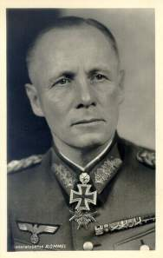
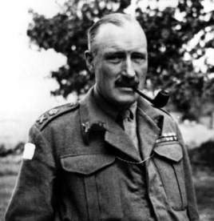
After the British relief of Tobruk during Operation Crusader, Erwin Rommel was forced to retreat to El Agheila where he was able to build up his forces for a second offensive
Rommel
The new commander of the British 8th Army was Neal Ritchie, a staff officer with no real command experience
Ritchie

Slide 3
Opening moves
British
German
Italian
Units
xx
xx
xxx
7
21
XX Corps

Slide 4
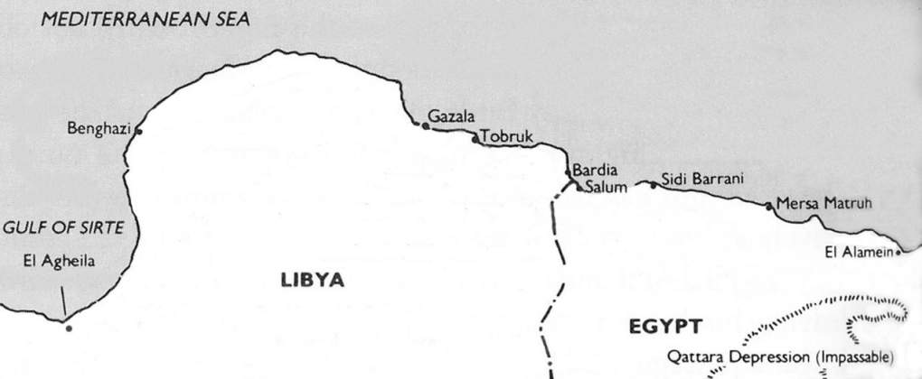
21 to 29 Jan, 1942
Gazala Line
x
xx
xx
4 IND
1 SA
xx
2 SA
50
xx
7
Bir Hachiem
xx
xxx
xx
xx
1
XX Corps
90
xxx
xxx
xx
15
XXI Corps
X Corps
21
British 1st Armored suffered losses but was not trapped – 21st Pz could not close the ring in time
Ritchie contemplated a counterattack with 1st Arm and 4th Indian but by that time, 1st Armored had been badly beaten and Rommel was threatening to surround Benghazi
7th Brigade, 4th Indian Div, fought its way out of Benghazi – Rommel, already suffering fuel shortages, could not pursue rapidly

Slide 5
Rommel reached the Gazala Line on 4 Feb and spent the next 4 months building up his forces to assault this position
By late May, when Rommel decided to attack, the British had a great advantage in the quality and quantity of their armor - Their forces now included including 200 of the new US Grant tanks supplied through Lend Lease
British = 914 tanks in 3 Armored Bdes and 2 Army Tank Bdes
175,000 men
Germans = 330 tanks Italians = 228 tanks
80,000 men
The pendulum seemed to have really swung to the British side but poor British leadership would squander this opportunity

Slide 6
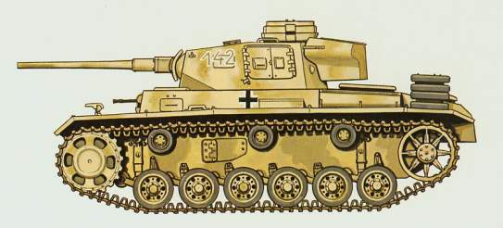
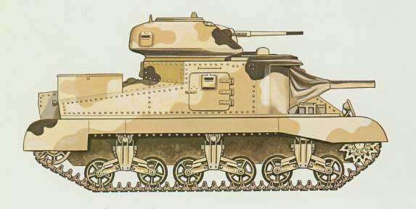
Armor upgrades for Rommel’s second offensive
Only 19 of
222 available Pz IIIs were the IIIJ model
Pz III J - long barreled 50mm gun
max armor = 50mm - penetration = 57mm at 500m
The 200 Grants were distributed among the 3 British Armored Brigades
Grant (American design) side mounted 75mm gun – turret – 37mm gun
max armor = 51mm – penetration (75mm) =70mm at 500m also fired HE

Slide 7
In the coming battles, British command and control would fail miserably - Ritchie was almost always a day behind the battle
Ritchie had no plan - always reacting to Rommel’s moves - He consulted his subordinates and acted on a consensus - command by committee
In this kind of battle, Rommel was at his best, commanding from the front responding rapidly to the flow of the battle

Slide 8
The Gazala Battles
27 May to 13 June, 1942

Slide 9
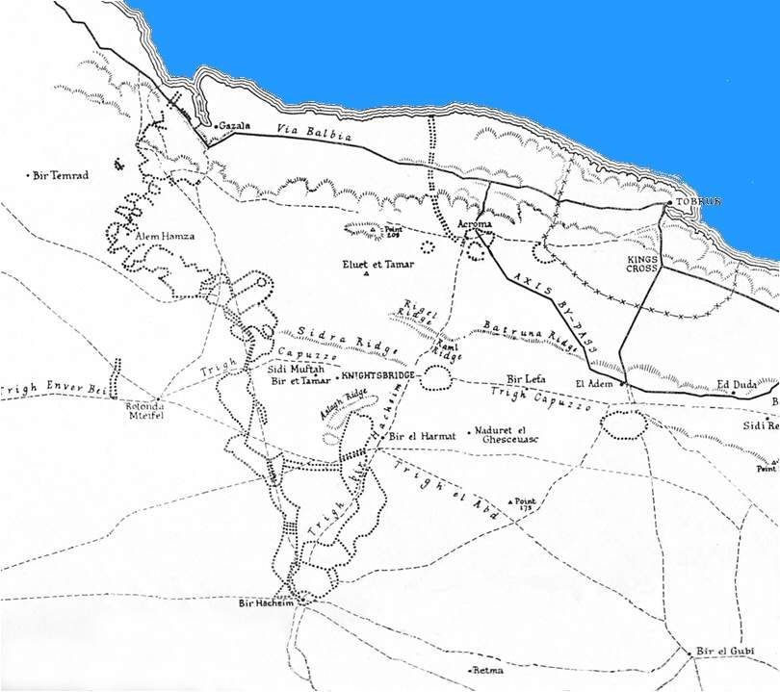
Minefields of the Gazala Line

Slide 10
Rommel’s initial plan was too ambitious – He would try to slip around the British left flank and surround the British forward units
xx
Trento
x
xx
1 SA
Bologna
x
1 SA
x
x
xx
x
2 SA
Brescia
32T
1 SA
x
x
x
xx
x
1T
x
50
2 SA
Pavia
xx
50
2 SA
Folgore
x
x
x
xx
50
201 GDS
2
x
Trieste
x
5 IND
xx
x
Ariete
22
III
5 IND
He did not foresee the heroic resistance of the Free French brigade at Bir Hacheim
III
15
III
x
21
III
15
4
xx
21
90
x
x
FF
x
3 MOT
7 MOT

Slide 11
27 May – phase1
xx
Trento
x
xx
1 SA
Bologna
x
1 SA
x
x
xx
x
2 SA
Brescia
32T
1 SA
x
x
x
xx
x
1T
x
50
2 SA
Pavia
xx
50
2 SA
Folgore
x
x
x
xx
50
201 GDS
2
x
Trieste
x
5 IND
xx
x
Ariete
22
III
5 IND
III
15
III
x
21
III
15
4
xx
21
90
x
x
FF
x
3 MOT
7 MOT

Slide 12
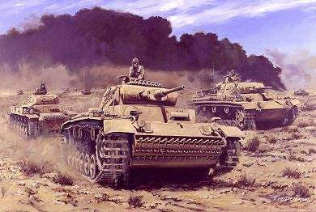

Ritchie was caught completely by surprise with his armor scattered instead of concentrated as Auchinleck had urged
British counterattacks would be weak and uncoordinated

Slide 13
27 May – phase2
xx
Trento
x
xx
1 SA
Bologna
x
1 SA
x
x
xx
x
2 SA
Brescia
32T
1 SA
x
x
x
xx
x
1T
x
50
2 SA
Pavia
xx
50
2 SA
Folgore
x
x
x
50
201 GDS
2
x
x
5 IND
x
22
5 IND
x
Rommel’s supply line was threatened by British light forces and the continued French presence at Bir Hacheim
III
4
III
15
III
xx
x
15
21
xx
Trieste
FF
III
90
x
xx
Ariete
21
7 MOT

Slide 14
Rommel had pushed so far north that his lead units were in danger of running out of fuel
He personally went south and guided several supply convoys to his tanks
Unaware of early British tank losses, Ritchie and his staff felt they had Rommel in a trap but the situation was changing so rapidly they could not decide on a strategy for closing the trap
Attacks on 28 May were initiated by various brigade commanders because of the lack of direction from above

Slide 15
On 29 May Rommel pulled back and consolidated his position inside the British minefields
28 May
xx
(The Cauldron)
Trento
x
xx
1 SA
Bologna
x
1 SA
x
x
xx
x
III
2 SA
Brescia
32T
1 SA
x
x
15
x
xx
x
1T
III
x
50
2 SA
Pavia
xx
50
III
21
2 SA
x
15
III
x
Folgore
x
22
x
xx
2
21
50
201 GDS
x
Ariete
xx
x
x
5 IND
90
Rommel decided to open a supply line through the British minefields – Would have to eliminate a brigade of 50 Div (150Bde)
4
5 IND
Some British replacement tanks were available – More uncoordinated attacks were made on 29 May
German AT held off the British assaults but the Germans also took losses
x
xx
FF
x
Trieste
7 MOT

Slide 16
As Rommel made preparations to destroy the British 150th Bde, the British high command wasted three days in meetings between Ritchie and his corps commanders
They felt they had Rommel in a trap but cold not agree on a strategy to close it – Ritchie made no attempt to take charge – It was command by committee
Finally, they decided they could be ready to assault Rommel’s position on 5 June – It would be far too late

Slide 17
By 1 June, the 150th Brigade was eliminated - A path through the mines was cleared shortly after
xx
Rommel had his
supply line
Trento
x
xx
1 SA
Bologna
x
1 SA
x
x
xx
x
2 SA
Brescia
32T
x
1 SA
x
x
xx
x
1T
x
50
x
2 SA
Pavia
xx
50
2 SA
III
III
22
Folgore
15
III
III
x
x
x
21
15
xx
2
21
201 GDS
50
xx
x
x
Ariete
90
4
5 IND
British armor charged into a devastating AT screen – Worse was to follow
x
5 IND
As the British prepared for their offensive before dawn on 5 June, Rommel opened another path through the minefields
x
xx
FF broke out on the night of 10 June
FF
x
Trieste
7 MOT
With British armor crippled, Rommel was ready to take Bir Hacheim

Slide 18
By 10 June, the British were down to 285 tanks of their original 914 – This still included 85 of the original 200 Grants
Because of the German advance, all the knocked out British tanks were in German hands
The Germans had only 124 of their original 330 tanks while Italian strength had fallen from 228 to 60 but repairs were possible – They had recovered most of their crippled tanks
Both sides had suffered heavy losses but British morale plummeted because of the growing mistrust in their leadership while Axis morale soared
Rommel was now ready to move in for the kill on a confused and slowly reacting British force

Slide 19
On the night of the 13th, 1 SA and 50 Divs climbed aboard their trucks, broke out and fled eastward – Afrika Korps was temporarily out of fuel
11 to 13 June
xx
Trento
x
xx
1 SA
Bologna
x
1 SA
x
xx
x
2 SA
Brescia
1 SA
x
x
x
xx
x
x
50
x
1T
2 SA
32T
x
2 SA
Pavia
xx
50
III
22
III
x
Folgore
x
21
21
x
5 IND
x
xx
4
201 GDS
2
Ariete
III
After the battle east of Knightsbridge the British had only 70 operational tanks from their original 914
x
15
xx
7 MOT
xx
90
III
Trieste
15

Slide 20
Just as the British were suffering their worst defeat of the campaign, Auchinleck, in Cairo, received a message from Churchill;
“Presume there is no question in any case of giving up Tobruk. As long as Tobruk is held, no serious enemy advance into Egypt is possible…”
This message amounted to a direct order from the Prime Mininster that Tobruk was to be held at all costs – Churchill was again meddling in military matters
What made the message so obnoxious was that a decision had been made months ago (approved by the General Staff) that no attempt would be made to hold Tobruk if things went badly - The minefields had been partly removed, many anti tank ditches filled in and a command and control center for artillery had been dismantled
This was Churchill at his worst, changing strategy in the middle of a campaign, perhaps to make political points

Slide 21
Auchinleck had no choice but to order Ritchie to hold Tobruk at all costs
Ritchie had already ordered the 1st SA and the 50th Divisions to move east to the Egyptian border – He had only the 2nd SA Div, an Indian Brigade, 201 Guards Brigade and remnants of the 1st and 32nd Tank Brigades to hold Tobruk – There was almost no artillery within the Tobruk perimeter
Churchill’s message had doomed these formations to destruction or capture

Slide 22
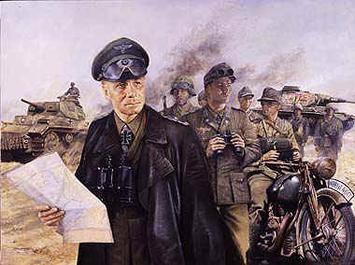
On 18 June - Rommel prepared to attack Tobruk
The town fell on 21 June - 33,000 prisoners - Huge amount of food, and fuel plus many British trucks also captured
Rommel insisted on pursuing defeated 8th Army into Egypt
German High Command urged a halt - Hitler overruled them - Rommel can go to Egypt – A mistake – Rommel’s over-stretched supply line led him into a disaster at El Alamein

