Slide 1

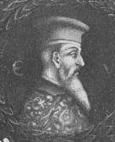
Torvioll
June 29, 1444
Strategic Context
The Ottoman Empire recovers from its decade-long civil war in 1415, and subsequently seeks to reestablish control over Albania, a region characterized by rough mountainous terrain, and loose assemblies of family tribes. The Castriot family accepts Ottoman rule in 1417, and with the support of the Ottomans, quickly becomes one of the strongest Albanian families. By 1431, the Ottomans regain direct control of much of the region. In 1437, the Castriot family head, John, dies. Instead of allowing his son George Castriot to control the family holdings, a military commander already in Ottoman service as Iskander Bey or Scanderbeg, the Sultan orders the Ottoman governor of Kroya to rule Castriot lands. As soon as the Ottomans became preoccupied with fighting against the Crusade of Varna in 1443, Scanderbeg revolts, seizing Kroya by deception and then regaining Castriot fortresses across the region. In March 1444, Scanderbeg unites many of the Albanian families in the Albanian League, provoking the Sultan to send an invading army under Ali Pasha to once again restore Ottoman rule.
To view animation on PC: hit F5
To view animation on Mac: hit ⌘ + enter
Stakes
+ An Albanian victory would weaken an already strained Ottoman Empire facing multiple threats.
+ An Ottoman victory would splinter the young Albanian League.
No Image
Available
By Jonathan Webb, 2015

Slide 2
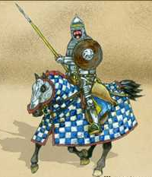
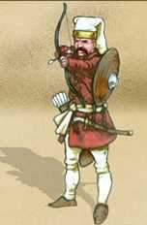
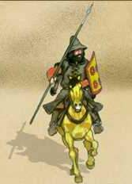
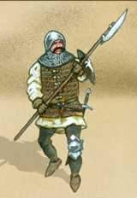
Torvioll, 1444
Strength
Albanians
Well
Ottomans
Well
Skanderbeg
Ali Pasha
15,000
25,000
By Jonathan Webb, 2015

Slide 3
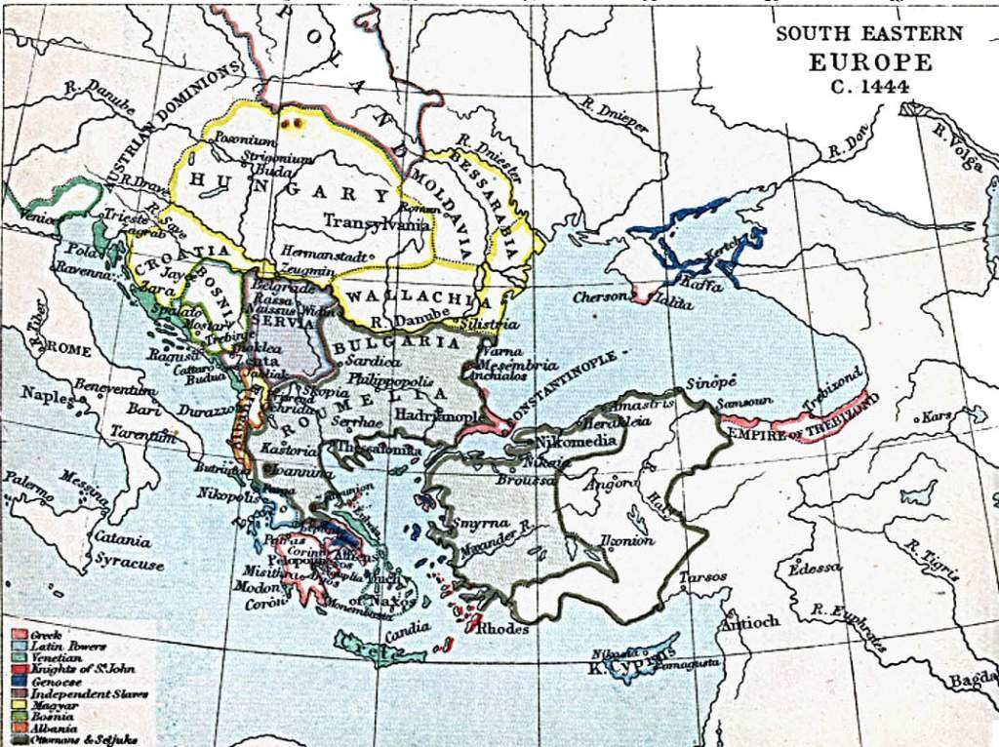

Southeastern Europe c. 1444

Slide 4
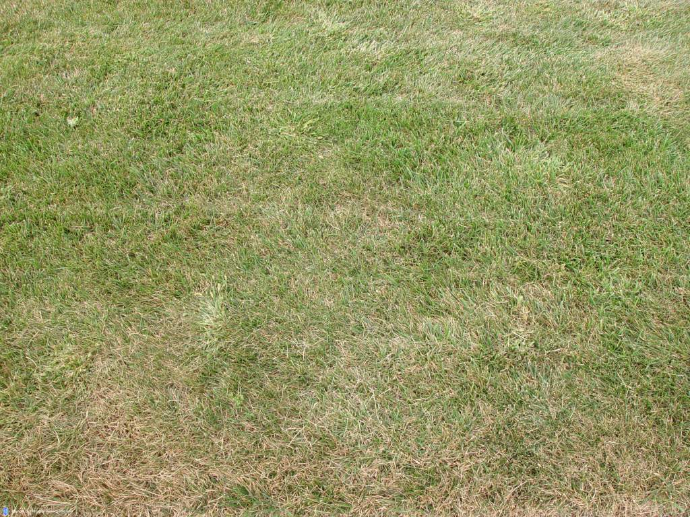
The battlefield consists of a portion of the narrow Black Drin valley, flanked by woods and hills on both sides. Beyond the battlefield shown is hills and more woods. The slope of the actual battlefield is gentle and grassy however.
Ottomans
(Ali Pasha)
Albanians
(Skanderbeg)

Slide 5
Ali Pasha deploys his army in standard Ottoman formation: light infantry and cavalry in the vanguard, elite Janissary infantry in the center, cavalry on both flanks and to the rear. Ali Pasha plans to simply sweep the outnumbered Albanians from the field with a downhill frontal attack. Skanderbeg commands his elite cavalry in the center with a cavalry/infantry mix on each wing. Scanderbeg maintains a reserve of cavalry and infantry, and an ambush force of cavalry in the woods on his right, both under Hamza. Skanderbeg plans to lure the Ottomans in with an archer screen and then ambush their left flank once completely committed.
Ali Pasha orders the advance. Skanderbeg covers his archers’ withdrawal with his cavalry as the Ottoman cavalry rush forward. The Ottoman advance is uneven, the left engaging the Albanians before the rest.
The Ottomans engage the rest of the Albanian front as the Ottoman left drives the Albanian right back. Hamza commits the cavalry reserve and prematurely springs the ambush before the Ottomans are completely engaged; the attack nonetheless achieves surprise and concentrates superior forces against the Ottoman left. In the center, the Albanian reserve infantry are committed as Ali Pasha pours more forces into the fight.
Almost completely surrounded, the Ottoman left begins to disintegrate against superior force. Meanwhile, the Albanian center and left push back their Ottoman opposition.
The Ottoman left is surrounded and destroyed, causing the Ottoman center and right to also rout, followed by the rest of the Ottoman army. Skanderbeg pursues with his cavalry, capturing the Ottoman baggage train.
Albanians
(Skanderbeg)
15,000
Ottomans
(Ali Pasha)
Symbol guide
Mois Dibra
Albanians Ottomans
Infantry Janissary infantry
Cavalry Cavalry
Archers Archers
Skanderbeg
Tanush Thopia
Tanush Thopia
Ottomans
(Ali Pasha)
25,000
Hamza
Albanians
(Skanderbeg)

Slide 6
Torvioll, 1444
Casualties & Aftermath
Albanians:
Ottomans:
2,780
or
19%
7,500
or
30%
Skanderbeg’s victory was only the first battle of many years of struggle for Albania as Skanderbeg faced constant threats internally from rebellious Albanian families as well as externally. The Venetians, exploiting an Albanian blood feud, attacked Albania in 1447 but were also defeated by Skanderbeg. In 1448, the Ottomans defeated the Crusade of Varna at the Battle of Kosovo and again turned their attention to Albanian. Sultan Murad II launched fresh invasions in 1449-1450 but Skanderbeg defeated the Ottomans at the Siege of Kroya. Skanderbeg died in 1468, after which Albanian resistance began to seriously falter, Albanian simply being too small to resist the Ottoman Empire with hit-and-run attacks forever. By 1479, the Ottomans once again controlled most of Albania.
By Jonathan Webb, 2015

Slide 7
The Art of Battle:
Animated Battle Maps
http://www.theartofbattle.com
By Jonathan Webb, 2015

