Slide 1

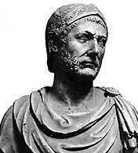
Lake Trasimene
June 24, 217 BC
Strategic Context
In 218 BC, Hannibal Barca negates Roman control of the seas by leading the Carthaginians through Spain to attack Roman territory, igniting the Second Punic War. Hannibal quarters his troops among the Cisalpine Gauls during the winter following his victory at the Trebia. In spring 217 BC, Rome sends two new armies of 40,000 and 20,000 to block the 30,000-strong Carthaginian army’s route to the capital. Hannibal marches his army through the snowy Apennine passes and exhausting Arnus marshes, outflanking both Roman armies and preventing any link up between them. Gaius Flaminius, leading the larger Roman army, immediately marches south to seek battle and obtain all the glory for defeating Hannibal.
To view animation on PC: hit F5
To view animation on Mac: hit ⌘ + enter
Stakes
+ A Carthaginian victory would allow Hannibal to march south and establish a base closer to the Roman capital.
+ A Roman victory would deny the Carthaginians a secure base in Italy.
No Image
Available
By Jonathan Webb, 2008

Slide 2
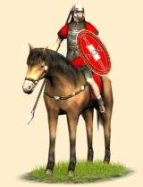
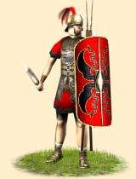
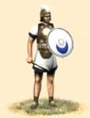
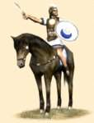
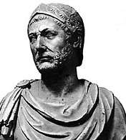
Lake Trasimene, 217 BC
Strength
Carthaginians
Well
Romans
Well
Hannibal
Gaius Flaminius
22,000 infantry
36,000 infantry
8,000 cavalry
4,000 cavalry
By Jonathan Webb, 2008

Slide 3
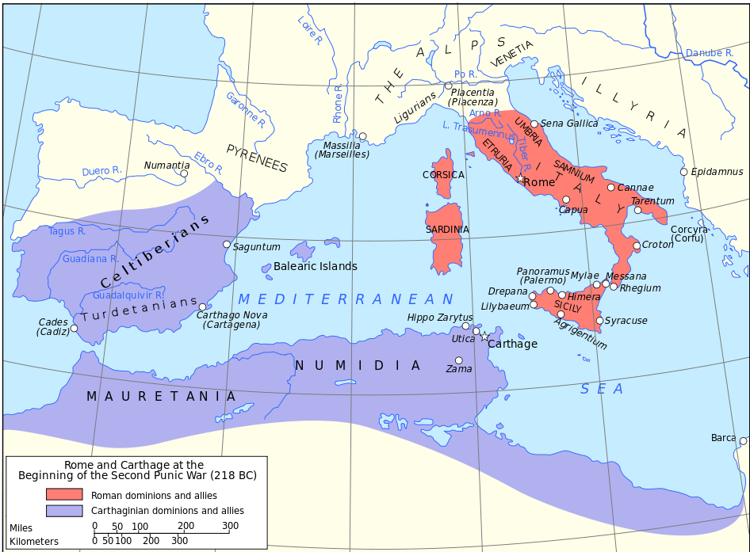
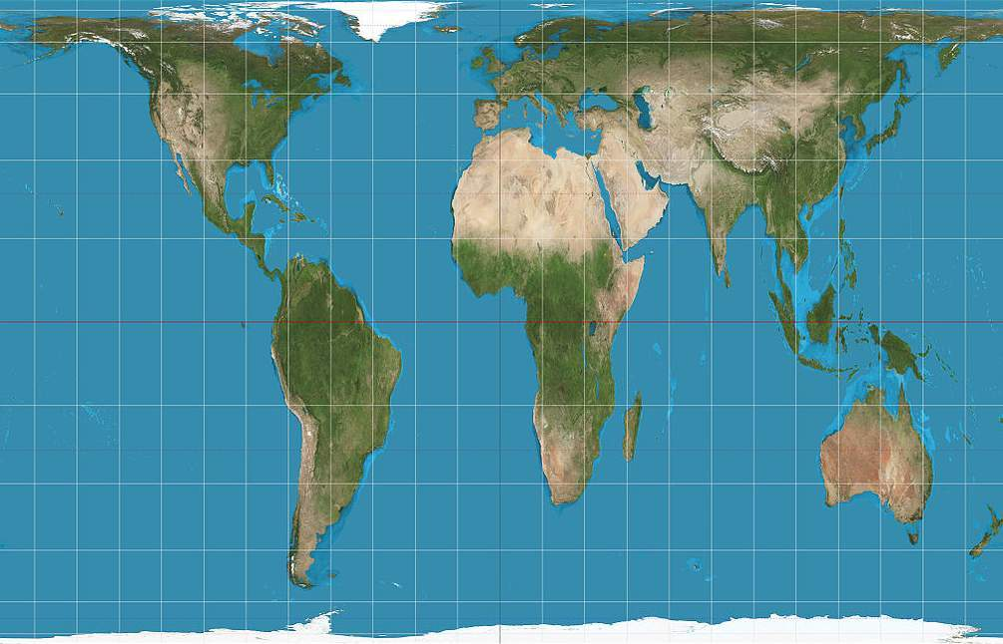
Mediterranean c. 218 BC

Slide 4

The battlefield consists of rough terrain next to Lake Trasimene, a smallish lake 10-12m deep. The only open lane around the lake if approaching from the more open south and west valley is the narrow defile on the lake’s north side. This lane is restricted by the rugged, forested hills to the north, becoming even narrower to the east. The defile features low visibility during the daily morning mist.
0
500m
1 km
Carthaginians
(Hannibal)
Romans
(Flaminius)

Slide 5
The Roman advance guard vaguely spots the Carthaginian camp at the eastern end of the ravine and charges forward. It is now that Hannibal springs the trap; the main Carthaginian force charges downhill with a thunderous cry. The cavalry sweep around the Roman rear to cut off any retreat as the infantry smash the Roman flanks. The Roman soldiers are blind to the disaster unfolding around them and can barely even form ranks to fight.
Flaminius deploys his force in column formation, heavy infantry acting as an advance guard and cavalry as the rearguard. Hannibal deploys an infantry unit and camp in plain view of anyone entering the ravine to serve as bait and his remaining units uphill out of sight to serve as the ambush force.
Flaminius orders the long column forward in the hopes of surprising the Carthaginian camp. Hannibal meanwhile waits for the Roman column to be completely astride the lake and for the daily morning mist to shroud the Roman soldiers’ vision.
The Romans do not recover from the initial shock and panic, and are slaughtered along with their commander, Flaminius. Only the advance guard and some lucky infantry are able to scatter into the mountains.
0
500m
1 km
Carthaginians
(Hannibal)
Carthaginians Romans
Infantry Infantry
Light infantry
Cavalry Cavalry
Camp
Romans
(Gaius Flaminius)
36,000 infantry
4,000 cavalry
Carthaginians
(Hannibal Barca)
22,000 infantry
8,000 cavalry
Symbol guide
Romans
(Flaminius)

Slide 6
Lake Trasimene, 217 BC
Casualties & Aftermath
Carthaginians:
Romans:
1,500
or
5%
30,000
or
75%
Hannibal was able to ambush and destroy an entire Roman army at little cost but could not exploit the victory. Hannibal marched south in the hopes of being joined by cities and tribes he considered to be vassals but was disappointed. The Roman Senate was shocked by the loss of another field army and consequently appointed Quintus Fabius as Dictator. Fabius soon gained the nickname as the “Delayer” for his avoidance of Hannibal and scorched earth tactics. This gained Rome the time to create yet another field army, 87,000 strong, only to be destroyed by Hannibal at the Battle of Cannae in 216 BC. After years of military disasters, Rome finally recovered and defeated Carthage in 202 BC.
By Jonathan Webb, 2008

Slide 7
The Art of Battle:
Animated Battle Maps
http://www.theartofbattle.com
By Jonathan Webb, 2008

